Slide 1
Classical Planning
Introduction to Artificial Intelligence
Dr Neil Urquhart

Slide 2
What is planning?
Problems may be solved by planning.
A plan describes how to solve a problem

Slide 3
What is a plan?
We commence with a initial state
We follow a series of actions
We end up at a goal state

Slide 4
What is a plan? Example…..
We commence with a initial state
  We have some planes and goods at various airports
We follow a series of actions
  Load the goods onto planes and fly them to their destinations then unload
We end up at a goal state
  All of the goods and planes are now at their destination

Slide 5
Problem solving with plans
We have start state
There will be a number of predefined actions that we can carry out to alter the state of our problem
We have a an end state which represents where we wish to be
We can (potentially) solve the problem by finding a sequence of actions which move the problem from the start state to the goal state

Slide 6
A simple example: Scenario
We have a goods g
We have a truck t
We have a location Edin
We have a location Glas

Slide 7
A simple example: Actions
Drive(truck, start, destination)
  Drives the truck from the start to the destination
  Assumes that the truck is at the start
Load(truck, goods)
  Loads the goods onto the truck
  Assumes that the truck and goods are at the same location
Unload(truck, goods)
  Unload the goods from the truck
  Assumes that the goods are on the truck

Slide 8
A simple example: Initial state
Goods g @ Location Edin
Truck t @ Location Edin

Slide 9
A Simple Example: Goal
Goods g @ Location Glas
Truck t @ Location Edin

Slide 10
A simple example: A plan
Load(t,g)
Drive(t,edin,glas)
Unload(t,g)
Drive(t,glas,edin)

Slide 11
A simple example: A plan
Load(t,g) Load the goods at Edin onto the truck
Drive(t,edin,glas) Drive the truck and goods to Glas
Unload(t,g) Unload the truck in Glas
Drive(t,glas,edin) Drive the truck back to Edinburgh

Slide 12
A simple example: A plan
Load(t,g) Load the goods at Edin onto the truck
Drive(t,edin,glas) Drive the truck and goods to Glas
Unload(t,g) Unload the truck in Glas
Drive(t,glas,edin) Drive the truck back to Edinburgh
Goal state reached! The goods g are at Glas (step 3) and the truck t is back in Edin(step 4)

Slide 13
A more complex example…
Assume we have trucks, goods, locations and actions as before
Each lorry can only carry 1 item of goods
Start State:
  Lorry l1,l2,l3 @ Edin
  Goods g1,g2 @ Glas
  Goods g4,g5 @ Perth
End State
  Lorry l1,l2,l3 @ Edin
  Goods g4@ Glas
  Goods g1@ Perth
  Goods g2,g5@ Edin

Slide 14
Can we come up with a solution?
drive l1 -Edin - Glas
drive l2 - Edin - Glas
drive l3 - Edin - Perth
load l1, g1
load l2, g2
load l3, g4
drive l1 Glas - Perth
unload l1 == G1 now in Pert
drive l2, Glas - Edin
unload g2, Edin = g2 now in Edin, l2 now in Edin
drive l3, Peth Glas
unload g4, glas = g4 now in Glas
drive l3, Glas, Edin = l3 now in Edin
load l1, g5
drive l1, Perth - Edin
unload l1 = g5 now in Edin, l1 now in Edin

Slide 15
PDDL
Planning Domain Definition Language
Allows us to formally specify planning problems
Allows automated planning

Slide 16
A PPDL Action…
Action(Fly(p,from,to),
PRECOND: At(p,from) Ʌ Plane(p) Ʌ Airport(from) Ʌ Airport(to)
EFFECT:¬At(p,from) Ʌ At(p,to))
This action moves an aircraft p between from and to .

Slide 17
A PPDL Action…
Action(Fly(p,from,to),
PRECOND: At(p,from) Ʌ Plane(p) Ʌ Airport(from) Ʌ Airport(to)
EFFECT:¬At(p,from) Ʌ At(p,to))
A PDDL action consists of:
Name and a list of variables used
Precondition: defines the states in which the action can be executed
Effect: defines effect of the action on the variables

Slide 18
Example (from the book): Air Cargo Transport
Init(At (C₁, SFO)Ʌ At(C₂, JFK) Ʌ At(P₁, SFO) Ʌ At(P₂, JFK) Ʌ
Cargo(C₁) Ʌ Cargo(C₂) Ʌ Plane(P₁) Ʌ Plane(P₂) Ʌ Airport(SFO) Ʌ Airport(JFK)
Goal(At(C₁,JFK) Ʌ At(C₂,SFO))
Action(Load(c,p,a),
PRECOND:At(c,a) Ʌ At(p,a) Ʌ Cargo(c) Ʌ Plane(p) Ʌ Airport(a)
EFFECT:¬At(c,a) Ʌ In(c,p))
Action(Unload(c,p,a),
PRECOND:In(c,p) Ʌ At(p,a) Ʌ Cargo(c) Ʌ Plane(p) Ʌ Airport(a)
EFFECT:At(c,a) Ʌ ¬In(c,p))
Action(Fly(p,from,to),
PRECOND:At(p,from) Ʌ Plane(p) Ʌ Airport(from) Ʌ Airport(to)
EFFECT: ¬ At(p,from) Ʌ At(p,to))

Slide 19
Example (from the book): Air Cargo Transport
Init(At (C₁, SFO)Ʌ At(C₂, JFK) Ʌ At(P₁, SFO) Ʌ At(P₂, JFK) Ʌ
Cargo(C₁) Ʌ Cargo(C₂) Ʌ Plane(P₁) Ʌ Plane(P₂) Ʌ Airport(SFO) Ʌ Airport(JFK)
Goal(At(C₁,JFK) Ʌ At(C₂,SFO))
Action(Load(c,p,a),
PRECOND:At(c,a) Ʌ At(p,a) Ʌ Cargo(c) Ʌ Plane(p) Ʌ Airport(a)
EFFECT:¬At(c,a) Ʌ In(c,p))
Action(Unload(c,p,a),
PRECOND:In(c,p) Ʌ At(p,a) Ʌ Cargo(c) Ʌ Plane(p) Ʌ Airport(a)
EFFECT:At(c,a) Ʌ ¬In(c,p))
Action(Fly(p,from,to),
PRECOND:At(p,from) Ʌ Plane(p) Ʌ Airport(from) Ʌ Airport(to)
EFFECT: ¬ At(p,from) Ʌ At(p,to))
Define our initial state

Slide 20
Example (from the book): Air Cargo Transport
Init(At (C₁, SFO)Ʌ At(C₂, JFK) Ʌ At(P₁, SFO) Ʌ At(P₂, JFK) Ʌ
Cargo(C₁) Ʌ Cargo(C₂) Ʌ Plane(P₁) Ʌ Plane(P₂) Ʌ Airport(SFO) Ʌ Airport(JFK)
Goal(At(C₁,JFK) Ʌ At(C₂,SFO))
Action(Load(c,p,a),
PRECOND:At(c,a) Ʌ At(p,a) Ʌ Cargo(c) Ʌ Plane(p) Ʌ Airport(a)
EFFECT:¬At(c,a) Ʌ In(c,p))
Action(Unload(c,p,a),
PRECOND:In(c,p) Ʌ At(p,a) Ʌ Cargo(c) Ʌ Plane(p) Ʌ Airport(a)
EFFECT:At(c,a) Ʌ ¬In(c,p))
Action(Fly(p,from,to),
PRECOND:At(p,from) Ʌ Plane(p) Ʌ Airport(from) Ʌ Airport(to)
EFFECT: ¬ At(p,from) Ʌ At(p,to))
Define our Goal

Slide 21
Example (from the book): Air Cargo Transport
Init(At (C₁, SFO)Ʌ At(C₂, JFK) Ʌ At(P₁, SFO) Ʌ At(P₂, JFK) Ʌ
Cargo(C₁) Ʌ Cargo(C₂) Ʌ Plane(P₁) Ʌ Plane(P₂) Ʌ Airport(SFO) Ʌ Airport(JFK)
Goal(At(C₁,JFK) Ʌ At(C₂,SFO))
Action(Load(c,p,a),
PRECOND:At(c,a) Ʌ At(p,a) Ʌ Cargo(c) Ʌ Plane(p) Ʌ Airport(a)
EFFECT:¬At(c,a) Ʌ In(c,p))
Action(Unload(c,p,a),
PRECOND:In(c,p) Ʌ At(p,a) Ʌ Cargo(c) Ʌ Plane(p) Ʌ Airport(a)
EFFECT:At(c,a) Ʌ ¬In(c,p))
Action(Fly(p,from,to),
PRECOND:At(p,from) Ʌ Plane(p) Ʌ Airport(from) Ʌ Airport(to)
EFFECT: ¬ At(p,from) Ʌ At(p,to))
Define our actions

Slide 22
A solution to our example
Load(C₁,P₁,SFO),
Fly(P₁,SFO,JFK),
Unload(C₁,P₁,JFK),
Load(C₂,P₂,JKF),
Fly(P₂,JFK,SFO),
Unload(C₂,P₂,SFO)

Slide 23
And now for something completely different…

Slide 24
The Spare Tire Problem
Init(Tire(Flat) Ʌ Tire(Spare) Ʌ At(Flat, Axle) Ʌ At(Spare, Trunk))
Goal(At(Spare,Axle))
Action(Remove(obj,loc),
PRECOND: At(obj,loc)
EFFECT: ¬ At(obj,loc) Ʌ At(obj,Ground))
Action(PutOn(t, axle),
PRECOND: Tire(t) Ʌ At (t,Ground) Ʌ ¬At(Flat,Axle)
EFFECT: ¬At(t,Ground) Ʌ At(t,Axle))
Action(LeaveOvernight,
PRECOND:
EFFECT: ¬ At(Spare,Ground) Ʌ ¬At(Spare,Axle) Ʌ ¬At(Spare,Trunk) Ʌ ¬ At(Flat,Ground) Ʌ ¬At(Flat,Axle) Ʌ ¬(Flat,Trunk))

Slide 25
The Spare Tire Problem
Init(Tire(Flat) Ʌ Tire(Spare) Ʌ At(Flat, Axle) Ʌ At(Spare, Trunk))
Goal(At(Spare,Axle))
Action(Remove(obj,loc),
PRECOND: At(obj,loc)
EFFECT: ¬ At(obj,loc) Ʌ At(obj,Ground))
Action(PutOn(t, axle),
PRECOND: Tire(t) Ʌ At (t,Ground) Ʌ ¬At(Flat,Axle)
EFFECT: ¬At(t,Ground) Ʌ At(t,Axle))
Action(LeaveOvernight,
PRECOND:
EFFECT: ¬ At(Spare,Ground) Ʌ ¬At(Spare,Axle) Ʌ ¬At(Spare,Trunk) Ʌ ¬ At(Flat,Ground) Ʌ ¬At(Flat,Axle) Ʌ ¬(Flat,Trunk))
What happens overnight ?!?

Slide 26
A plan to change tires
Remove(Flat,Axle)
Remove(Spare,Trunk)
PutOn(Spare,Axle)

Slide 27
Automated Planners
If we can specify a problem in PDDL then we can search for a solution automatically.
It’s not simple, there may exist a great number of possible plans
  Many will not take us to the goal state
  Some will take us to the goal state via many unnecessary states

Slide 28
An online planner
http://editor.planning.domains/#
Problems are split into two PDDL files
  Domain – defines actions and predicates
  Problem – defines an initial state and goal state

Slide 29
Examples
Logistics problems
  http://www.cs.utexas.edu/~vl/teaching/planning/pddl/strict-domains/logistics/
The Ferry problem
  http://www.cs.utexas.edu/~vl/teaching/planning/pddl/strict-domains/ferry/

Slide 30
Automated Problem Solving
We need to search for a plan that takes us to the goal state
One possibility is a tree search (state-space search)
  Our root node is the initial state
  We then have branch nodes for each state that we can reach using one valid action from the current state
The tree will grow very quickly and become very large for anything except the most trivial problem!
One option is to start from the goal state and the initial state and construct trees concurrently
  When they both find the same state, they have collectively found a plan
  Also know as Backward search or regression

Slide 31
Automated problem solving
As we know the beginning and end states we can think of our problem as a graph search
  Nodes represent problem states
  Arcs represent actions between problem states
It is possible to use A* to find a plan from within a graph
  The heuristic is problematic
  Need to be able to define how “close” a state is to solving the problem

Slide 32
Planning Graphs
A planning graph is a directed organised graph
It comprises levels
  S₀ representing the initial state
  A₀ represents those actions that are applicable in S₀
Keep adding levels until the graph has “levelled off”
  Levelling off occurs when consecutive levels of the graph are the same

Slide 33
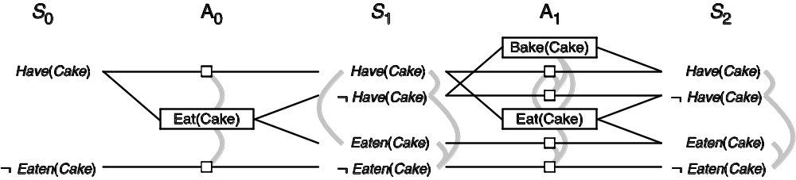
GraphPlan example
Init(Have(Cake))
Goal(Have(Cake) Ʌ Eaten(Cake))
Action(Eat(Cake)
PRECOND: Have(Cake)
EFFECT: ¬Have(Cake) Ʌ Eaten(Cake))
Action(Bake(Cake)
PREDCOND: ¬Have(Cake)
EFFECT: Have(Cake))

Slide 34
GraphPlan example
Rectangle indicate actions
Small squares indicate persistence actions
Mutex are shown as grey lines
  Mutually exclusive actions
  Actions/states linked by a mutex show that only one of them can hold true

Slide 35
GraphPlan example
This graph has levelled off at S₂
S₁ and S₂ are the same

Slide 36
GraphPlan example
Note that in S₂ we can have our cake and eat it
Trace back from S₂ and we get
Eat(cake)
Bake(cake)

Slide 37
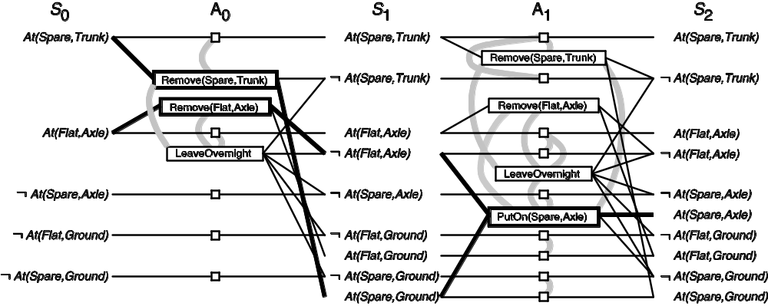
A more complex example…

Slide 38
Summary
Planning is branch of AI that allows us to formally solve problems
If we can express a problem in terms of states and actions then it may be possible to create a plan
  A plan consists of sequence of actions
  A successful plan takes us from the initial state to the goal state
PDDL allows us to formally express problems, states and actions
Automated solvers are available for PDDL

